Slide 1
Perineural Invasion Detection using Deep Learning: A Systematic review
Hayagreev Jeyandran, Vidyashilp Academy
hayagreevj@gmail.com

Slide 2
PNI: Occurrence and Prognostic Significance
PNI: Infiltration of tumour cells into any of the three layers of the perineurium.
Several theories of occurrence. Current research: mutual relationship guided by molecular signalling and nerve micro-environment.
Associated with metastasis and cancer recurrence.
Difficult to distinguish small peripheral nerves from benign glands, vascular tissue, etc.
Manifold visual appearances of invasion, differ based on organ histology.
Occur in small isolated regions
Scale
Morphology
Sparsity

Slide 3
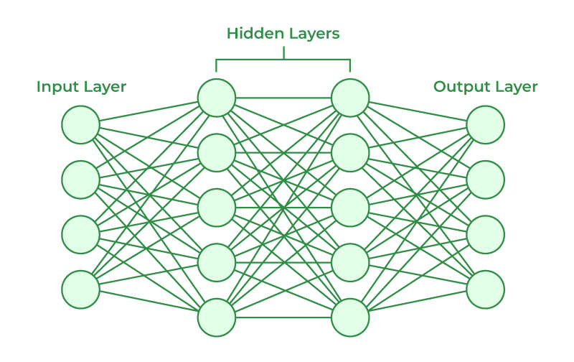
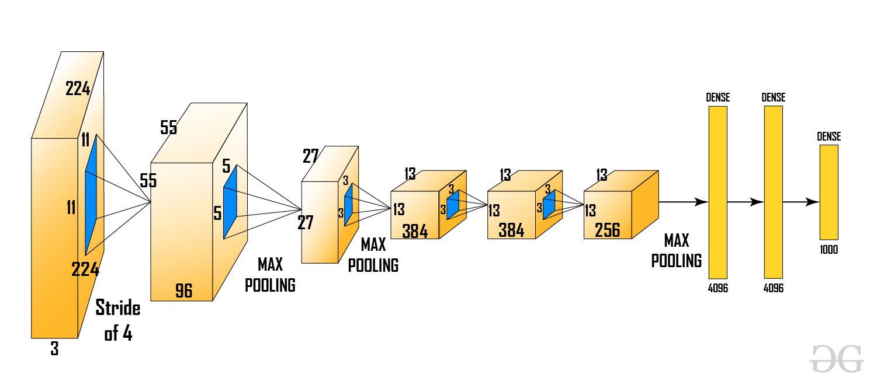
Deep Learning: An overview
Figure 1: Dense Nets: Motivation
Figure 2: ConvNets - Specialization
(x) Whole Slide image
(y) Probabilities/Bounding boxes/Segmentation maps for PNI presence and additional parameters
Image sources: GeeksForGeeks

Slide 4
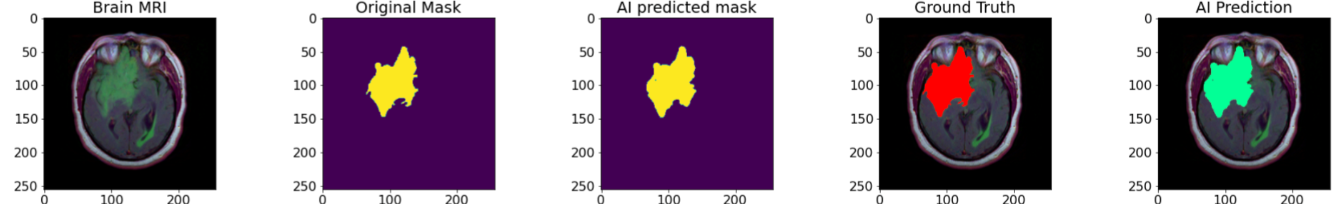
Deep Learning in Medical Imaging
Alleviates need for manual feature engineering.
Applied to CT, MRI, X-Rays, Pathology whole slide images.
Examples:
Nirschl et al. - Deep Learning classifier for clinical heart failure from WSIs.
Feng et al. – Colonoscopy image analysis (IEEE Journal of BioMed and Health Informatics)
Figure 3: Example of DL-based diagnosis (Source: Rohith04MVK – Github)

Slide 5
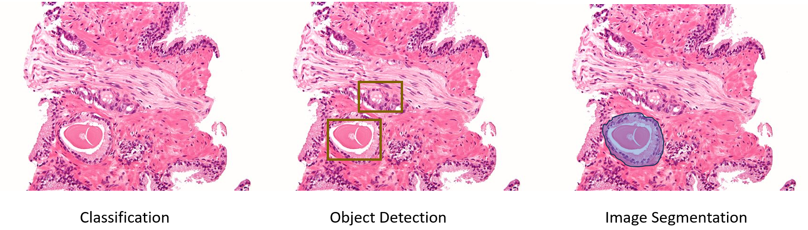
PNI Detection: Approaches
Figure 4: Techniques - Increasing order of annotation complexity
Assigning probabilities to entire image/subject.
Object detection: Rough bounding boxes around nerve/tumour.
Image segmentation: Pixel-wise classification.
Current research: Pancreatic (PDAC), Prostate, Colorectal, Gastric. Common types associated with PNI.
Rule-based classification

Slide 6
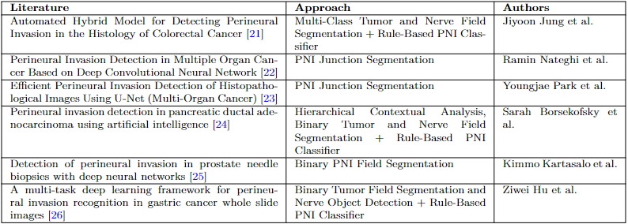
Reviewed Literature

Slide 7
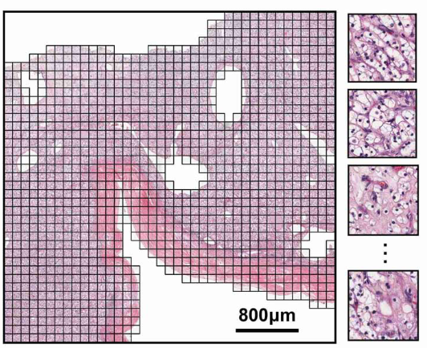
Dataset
Issues governing dataset access as opposed to other medical imaging tasks:
Pre-processing steps (such as patching, boundary dilation, data augmentation) and pre-training alleviate these issues.
Computational Resources: Powerful GPUs and TPUs, not easily accessible in a medical environment.
Annotation and Labelling: Expensive and time-consuming precision annotations.
Dimensionality: Pixel-level morphological diversity.
Figure 5: WSI Patching: Lu et al.

Slide 8
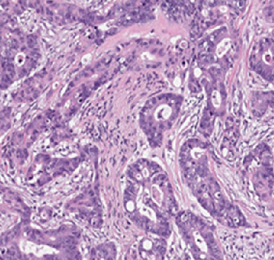
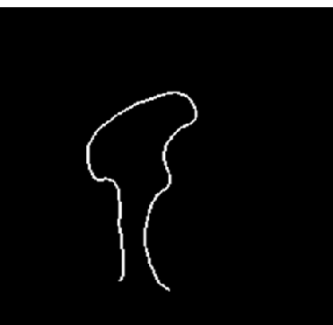
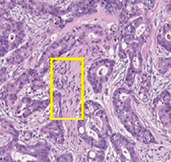
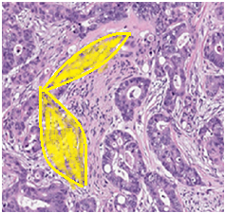
PNI Detection: Models
Multi-stage approach
Preferred method.
Localization using segmentation or detection of nerve/tumour/boundary, followed by rule-based classification.
End – to – End patch detection
Limited information but less annotation.
Rarely applied with small training set. Applied along with a localization model.
Model
Model
Patch PNI Probability: 0.785 Result: TRUE
Intersection over Union/ Intersection over Bounding box / Distance thresholding
Figure 6 – 9: Source – Nateghi et al.

Slide 9
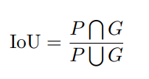
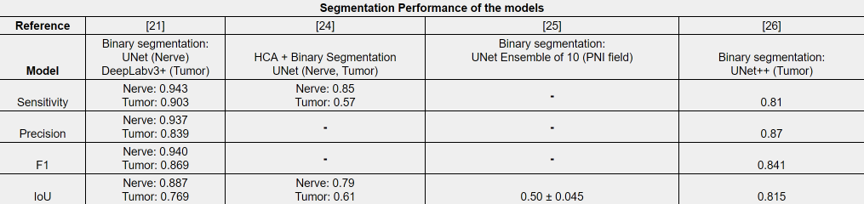
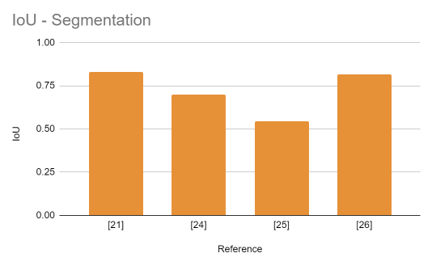
Evaluation metrics: Segmentation
False Negatives, False Positives, True Negatives, True positives identified pixel-wise.
P – Predicted masks
G – Ground truth masks
Overall higher scores for nerve compared to tumour.
Tumour can be highly irregular and diffuse across multiple patches of the same organ.
Nerves vary more between organs. Less noise in predictions.

Slide 10
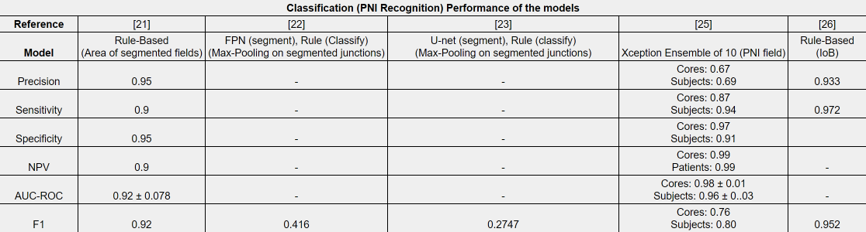



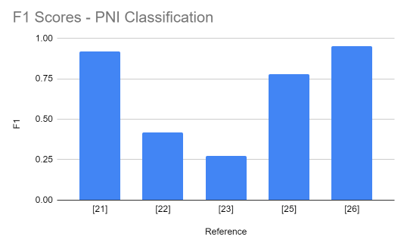
Evaluation metrics: Classification
False Negatives, False Positives, True Negatives, True positives identified patch-wise and subject-wise
[26]: Image segmentation, Nerve detection, rule-based. Most sophisticated approach, highest F1 score.
[21]: PNI field segmentation. More conservative due to precise masks compared to imprecise bounding boxes in [26], but decrease in sensitivity lowers F1 score.
End-to-end classification in [25] performs poorly.

Slide 11
Clinical Performance analysis
[24] – PNI in PDAC specimens
 | Range of inference time (s) | Median inference time (s) | Mean inference time (s)
All cases of PDAC | [1, 120] | 5.0 | -
Initially diagnosed as +ve | [1, 30] | 1.0 | 4.2
Initially diagnosed as –ve (re-diagnosed) | [1, 90] | 14.0 | 42.4
 | Positive cases | Negative cases
Pathology report | 31 (52.5%) | 28 (47.5%)
Trained model | 48 (81.4%) | 11 (18.6%)
P = 0.000088
18 cases from the initial 28 –ve were re-classified.
30 cases from the initial 31 +ve were classified as +ve. (1 case missed)
P < 0.001
Diagnostic challenge also perceived by model.

Slide 12
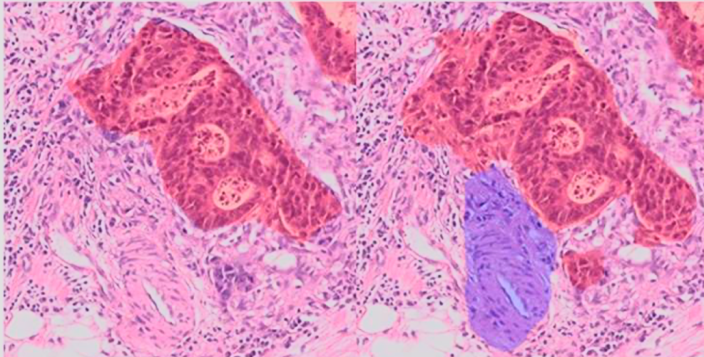
Algorithm Error Analysis
Misclassification of tumour
Benign glands in the vicinity
Inflammatory cells responding to tumour
Misclassification of nerve
Smooth Muscle cells (Spindle-shaped, like Schwann cells)
Mucinous Fibroplasia within malignant prostate tissue
Key to increase precision: Hyperparameter optimization. These models already use state of the art architectures. Consideration of inference time – pathologist workload trade off.
Fig 14: Vascular tissue misclassified as nerve (Source)

Slide 13

Discussion and Future work
Utilizing biomarker data (eg. PSA for PNI in Prostate cancer, Carcinoembryonic enzymes – associated with inflammation in tumor)
Pathological implementation:
Techniques to alleviate training cost eg: Model Pruning.
Trade-off strategy. Evaluation function reflecting both model accuracy and training cost.
Exploring cloud GPUs to provide budget estimates.
Effect of Pathological preservation and noise in input images.
Alleviate through special image filters/use an auxiliary model for image restoration.
Prioritizing inter-observer agreement (Cohen’s Kappa)
Different staining techniques
Usage of S100 stained (Schwann cell detection), Neurofilament stain etc. to provide contrast to enhance PNI expression.
Not a practical aspect. However, opens up avenues to explore specialized imaging techniques to achieve higher precision.

Slide 14
Thank you!
Presenter: Hayagreev Jeyandran (hayagreevj@gmail.com)

